Slide 1

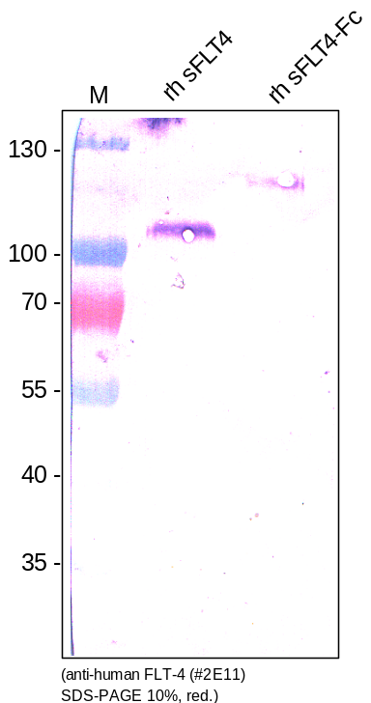
ReliaTech GmbH
Mouse anti-human VEGFR3/FLT-4 (#2E11)
(Cat #101-M37)
Figure 1. Western analysis of recombinant human soluble VEGFR3/FLT-4 using a mouse anti-human FLT-4 antibody [Cat# 101-M37].
http://www.reliatech.de / info@reliatech.de

